Slide 1
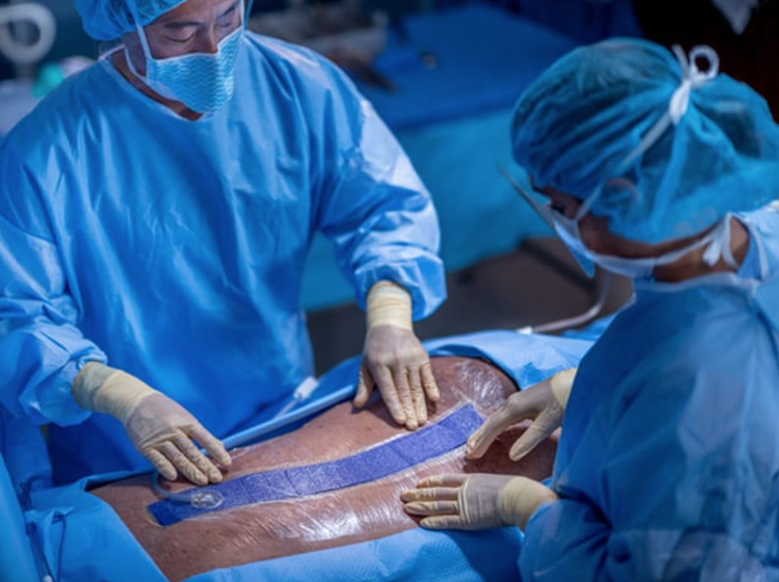

Incisional Negative Pressure Wound Dressings (iNPWD) for spinal fusions Literature review and review of our local experience at ARI between 1/7/2021 and 1/7/2023
Melania Geymonat Ramírez
Mr Mohit Arora

Slide 2
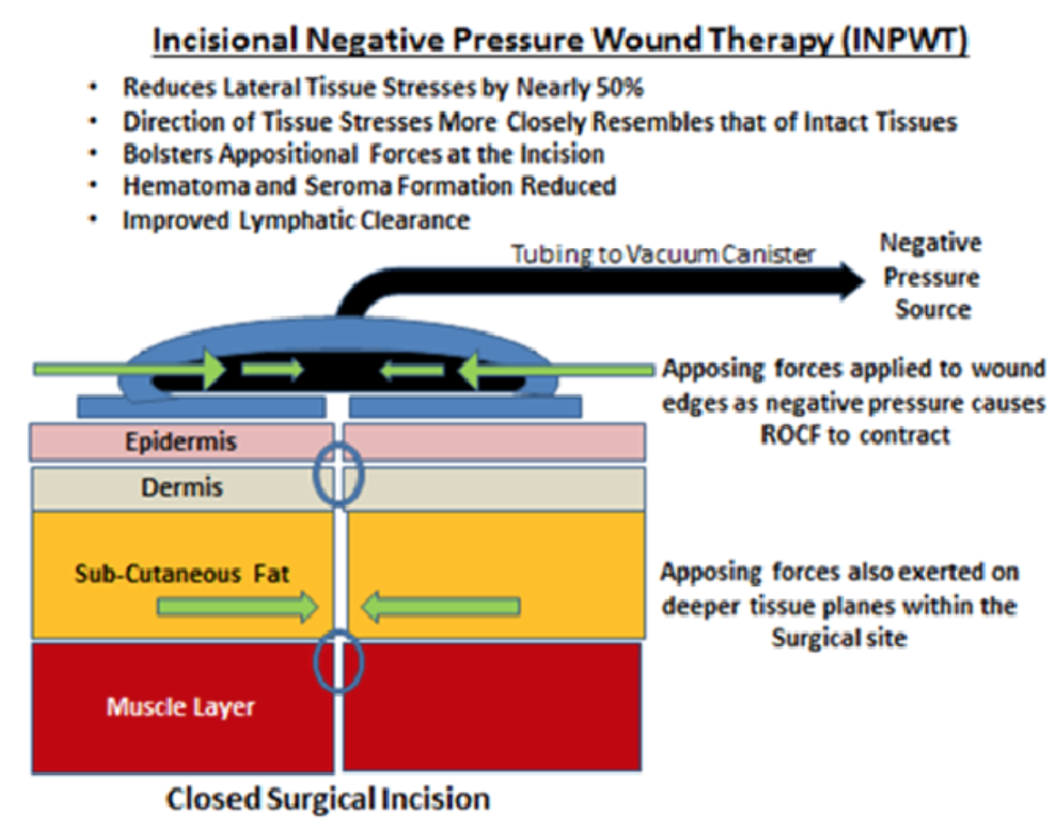
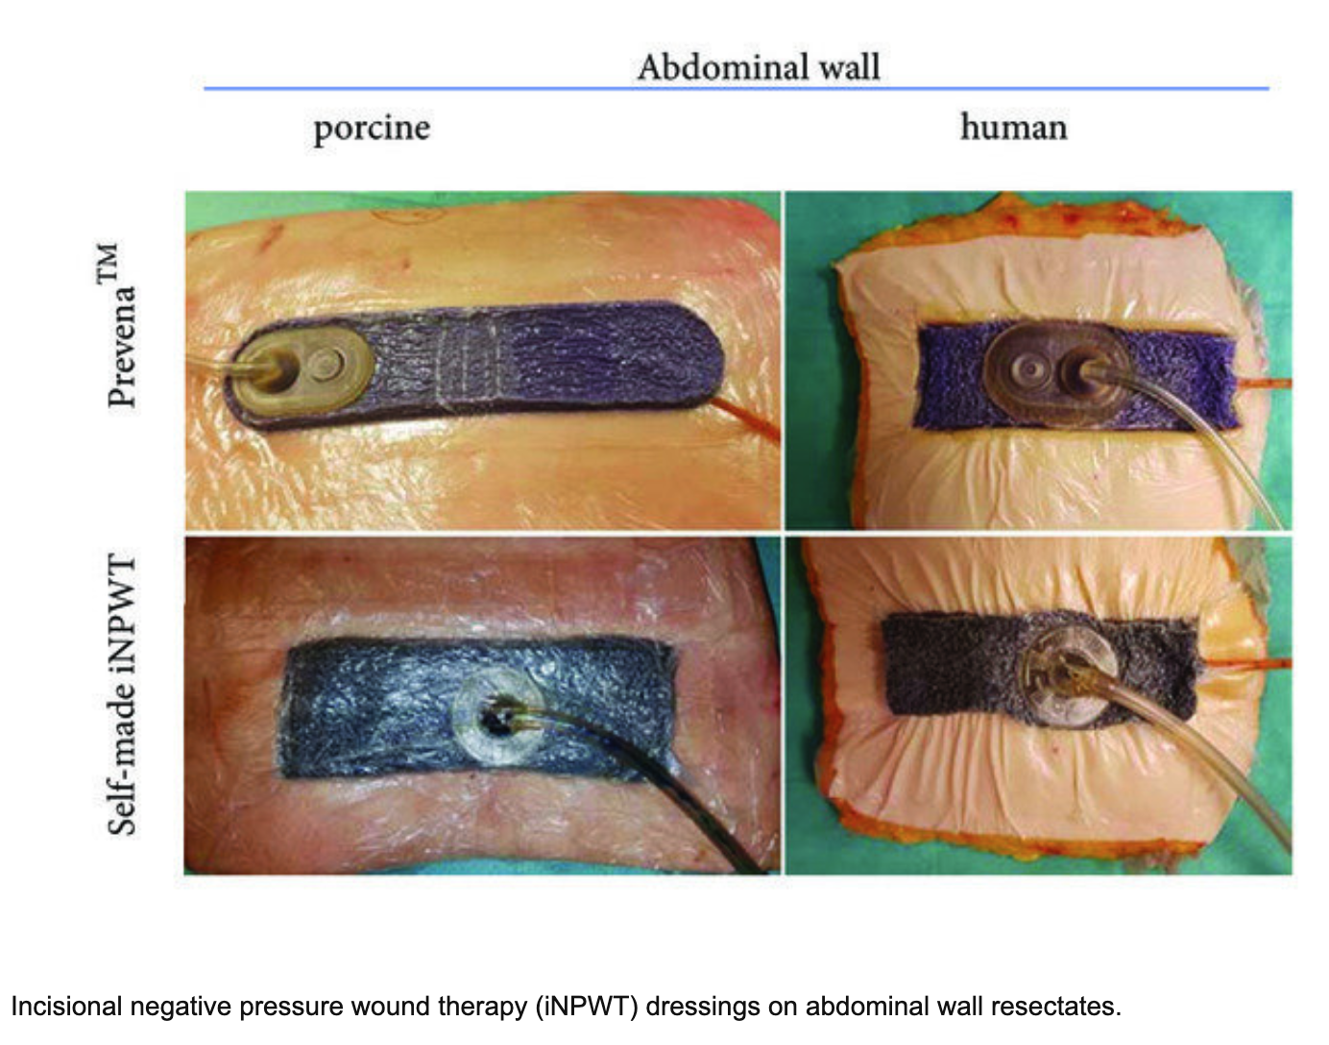
Incisional Negative pressure wound therapy (iNPWT)
NPWT: System that aids the optimization of wound healing through the application of sub-atmospheric pressure*
iNPWT: prophylactic use of NPWT on primary closed incisional wounds prevention of postoperative wound complications**
Benefits:
Reduces:
bacterial contamination
exudate
oedema
promotes lymphatic and local blood flow
stimulates tissue granulation*
*Negative Pressure Wound Therapy https://www.ncbi.nlm.nih.gov/books/NBK576388/
**The lancet https://www.thelancet.com/journals/eclinm/article/PIIS2589-5370(23)00282-1/fulltext
Notes:
Negative pressure wound therapy (NPWT) is a broad term used to describe a unique and versatile system that aids the optimization of wound healing through the application of sub-atmospheric pressure to help reduce inflammatory exudate and promote granulation tissue. It can be utilized to manage acute and chronic wounds, ranging from open fasciotomy wounds and diabetic foot ulcers to closed surgical incisions.
intraoperarively damage to surrounding nerves, blood vessels, and soft tissue.
System that aids the optimization of wound healing through the application of sub-atmospheric pressure
Adapted for the adjunctive treatment of closed wounds (closed surgical incisions, skin grafts).
Reduces edema and seroma formation
Prevents surgical dehiscence in high-risk incision sites
Promotes granulation to encourage healing. (3)
Benefits (hypothetized) -

Slide 3
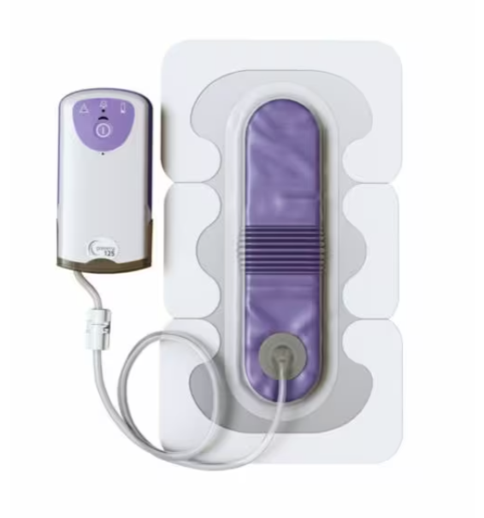
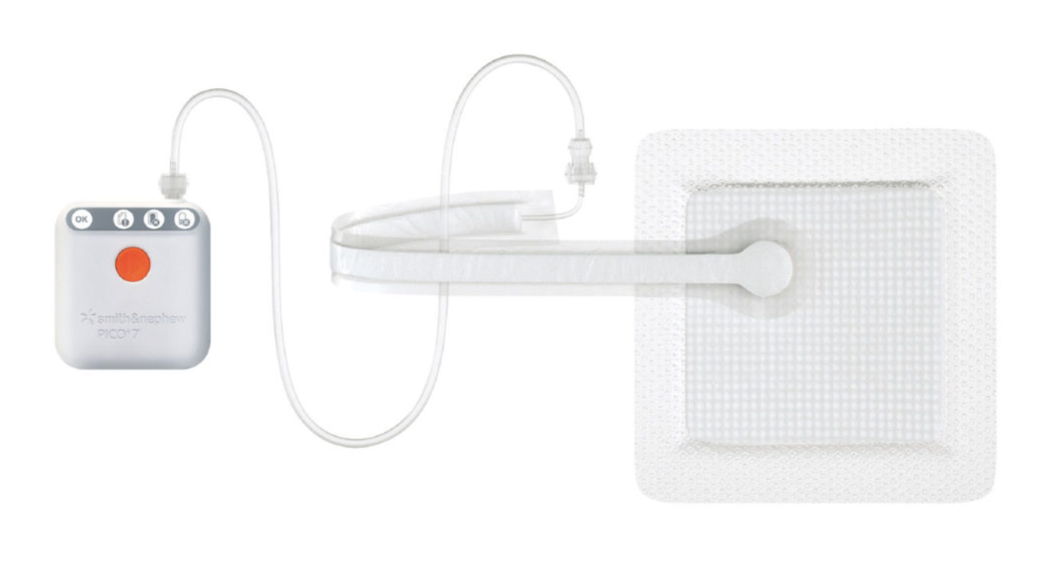
Associated known Complications
iNPWT:
Skin blisters and maceration
Pump failure*
Pressure sores
NPWT:
Pain, bleeding, infection
Hypersensitivity reaction to the dressing
Negative pressure erosion or necrosis
*NICE guidelines https://www.nice.org.uk/guidance/MTG43
Notes:
The committee noted that adverse events were rare in the studies but that skin blisters and maceration may occur when using PICO dressings. A clinical expert advised that skin blisters may develop because of skin tension, which is likely to be the result of the dressing being stretched over the wound. This was corroborated by the results of 1 study, in which the highest incidence of skin blisters was in people whose dressings were applied by trainee staff.
The company stated that there had been around 147 reported cases of the PICO pump failing since its launch in 2007. The committee considered that pump failure would incur additional costs, including application of additional dressings and pump replacement, but it acknowledged that the reported rates of pump failure were very low.

Slide 4
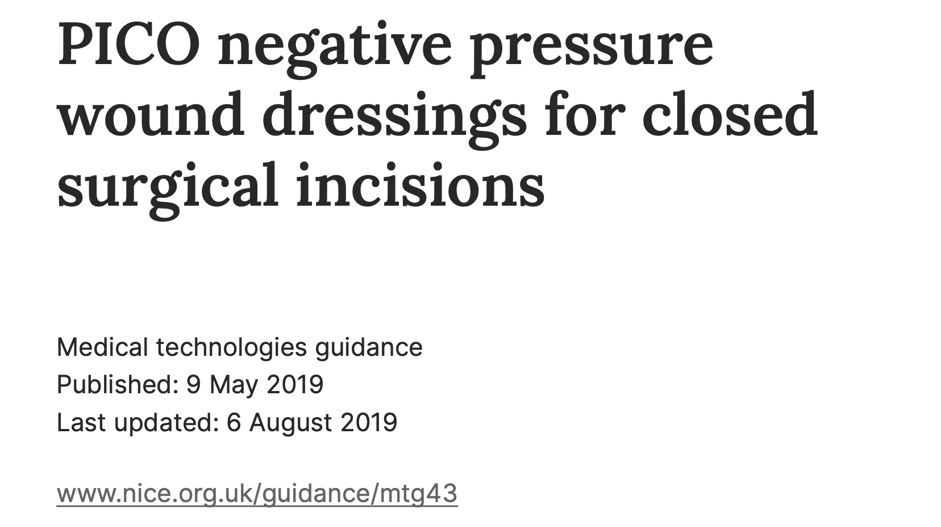
NICE Guideline (2019)
Evidence suggests:
Fewer surgical site infections
Reduces the rate of seromas
Not add to the overall costs of treatment
Recommenced for: Orthopaedic, Colorectal, Obstetric, Plastic/breast surgery, Vascular and Cardiothoracic surgery
No clear guidance from NICE to use this dressing in spinal surgery
*NICE guidelines https://www.nice.org.uk/guidance/MTG43
Notes:
31 studies:
15 were RCT
16 were non- randomised comparative observational studies
15 RCT Secondary or tertiary care
Preventing surgical site complications in people with closed surgical incisions who were at high risk of complications after surgery
One was done in the UK.
Reduces the rate of seromas compared with standard wound dressings.
Cost analyses suggest that using PICO dressings will not add to the overall costs of treatment. (NICE)

Slide 5
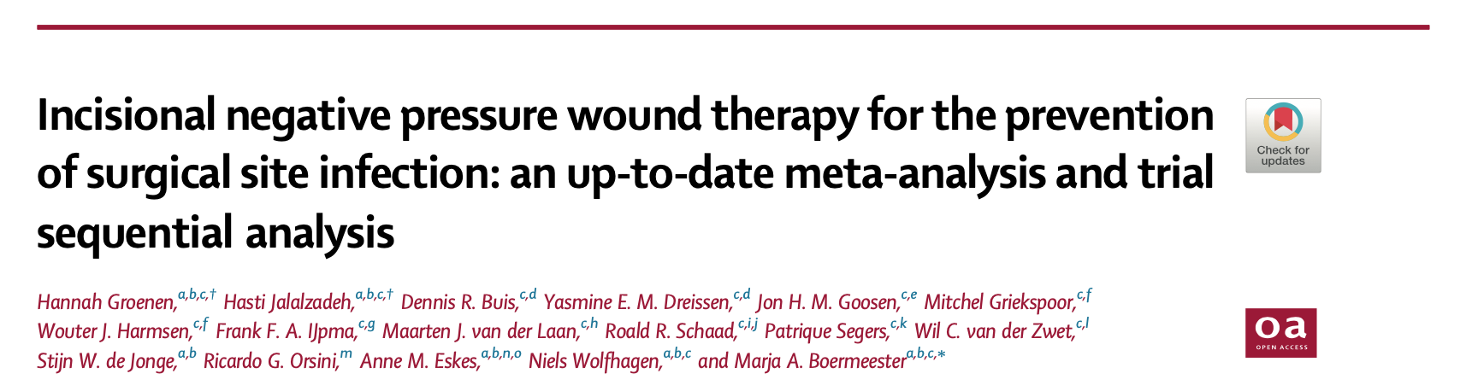
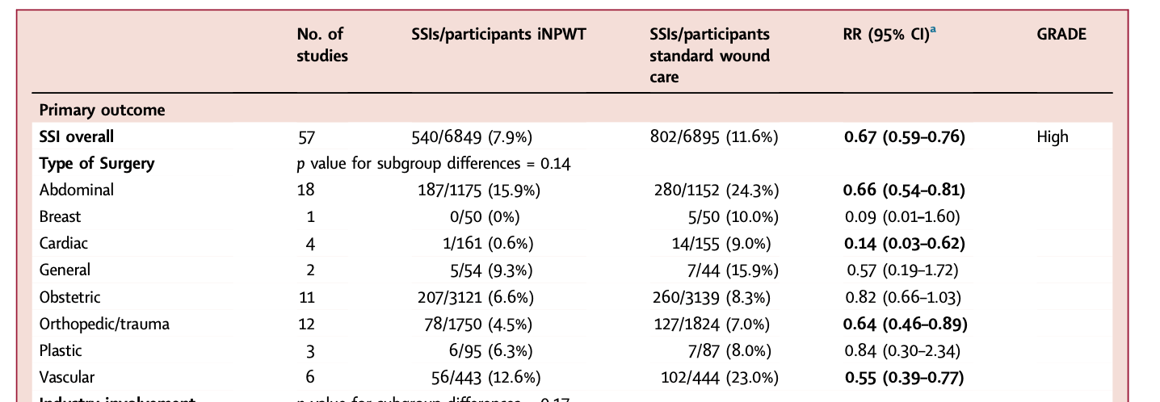
www.thelancet.com Vol 62 August, 2023
No clear guidance on this dressing in prophylactic use in spinal surgery
The Lancet meta-analysis (2023)
Findings
Systematic review:
57 RCTs with 13,744 patients
RR of 0.67
GRADE assessment shows high-certainty evidence that iNPWT is effective in reducing SSI
Uncertainty is less than in previous meta-analyses
Further trials are unlikely to change the effect estimate for the outcome of SSI
The Lancet https://www.thelancet.com/journals/eclinm/article/PIIS2589-5370(23)00282-1/fulltext
Notes:
Summary Background The evidence on prophylactic use of negative pressure wound therapy on primary closed incisional wounds (iNPWT) for the prevention of surgical site infections (SSI) is confusing and ambiguous. Implementation in daily practice is impaired by inconsistent recommendations in current international guidelines and published meta- analyses. More recently, multiple new randomised controlled trials (RCTs) have been published. We aimed to provide an overview of all meta-analyses and their characteristics; to conduct a new and up-to-date systematic review and meta-analysis and Grading of Recommendations Assessment, Development and Evaluation (GRADE) assessment; and to explore the additive value of new RCTs with a trial sequential analysis (TSA).
methods
Methods
PubMed, Embase and Cochrane CENTRAL - 8 general meta-analyses vs present meta-analysis
from database inception to October 24, 2022
meta-analyses covering all surgical specialties and RCTs studying the effect of iNPWT compared with standard dressings in all types of surgery
on the incidence of SSI, wound dehiscence, reoperation, seroma, hematoma, mortality, readmission rate, skin blistering, skin necrosis, pain, and adverse effects of the intervention
We calculated relative risks (RR) with corresponding 95% confidence intervals (CI) using a Mantel- Haenszel random-effects model
We assessed publication bias with a comparison-adjusted funnel plot. TSA was used to assess the risk of random error. The certainty of evidence was evaluated using the Cochrane Risk of Bias- 2 (RoB2) tool and GRADE approach. This study is registered with PROSPERO, CRD42022312995.
findings
Compared with previous meta-analyses, the RR stabilised, and the confidence interval narrowed. In the TSA, the cumulative Z-curve crossed the trial sequential monitoring boundary for benefit, confirming the robustness of the summary effect estimate from the meta-analysis
Interpretation
if future research is to be conducted on iNPWT, it is crucial to consider what the findings will contribute to the existing robust evidence.

Slide 6
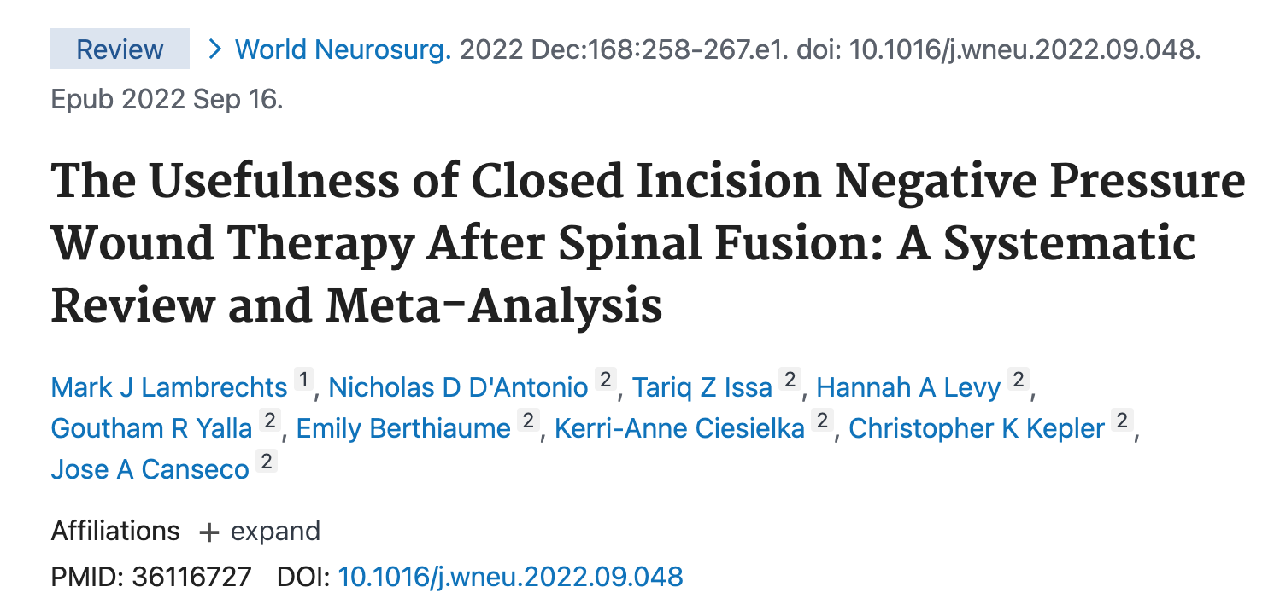
Evidence of iNWPT in spine
1 systematic review
3 meta analysis
4 observational studies
Systematic review
(Dec 2022, World Neurosurgery)*
ciNPWT may:
reduce the rates of SSI after spinal fusion
reduce postoperative wound complications
the meta-analysis was insufficiently powered to make this association
*https://pubmed.ncbi.nlm.nih.gov/36116727/

Slide 7
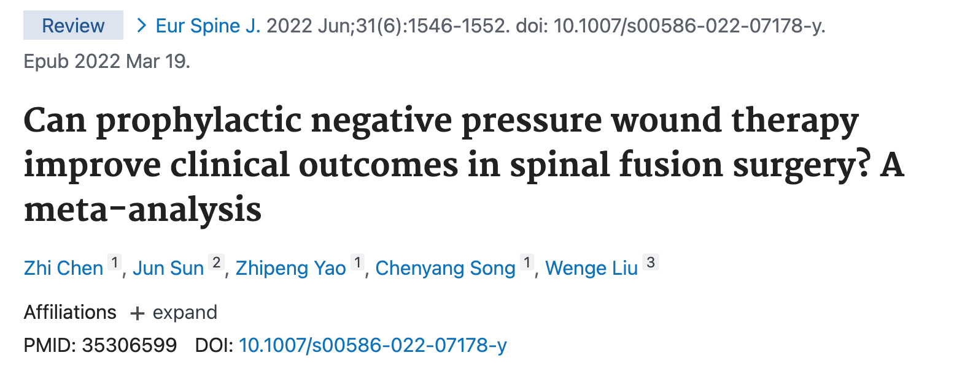
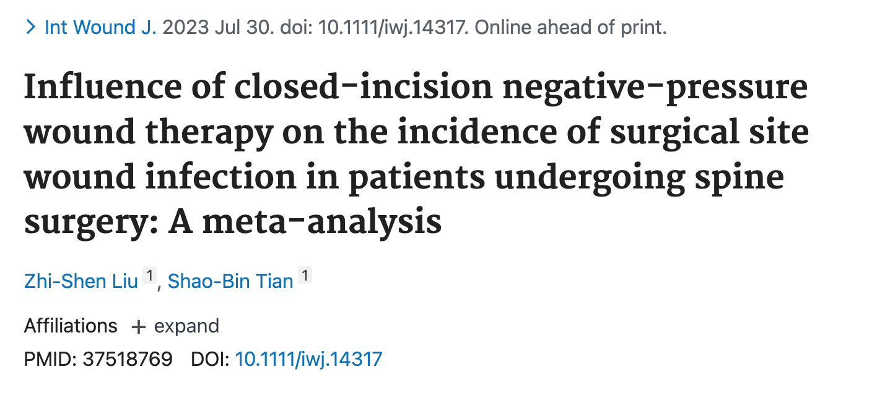
Evidence of iNWPT in spine (cont)
Meta-analysis (2022, European Spine Journal)
NPWT could effectively reduce postoperative surgical site infection
No significant benefit in reducing:
incidence of wound dehiscence
overall wound complication
readmission and reoperation.
Meta-analysis (July 2023, International Wound Journal)
Reduces the incidence of postoperative surgical site wound infections
Does not shorten hospital stay for patients.
*https://pubmed.ncbi.nlm.nih.gov/35306599/
**https://pubmed.ncbi.nlm.nih.gov/37518769/

Slide 8
Our Outcomes at Aberdeen Royal Infirmary
182 cases, retrospectively
Period of 1 July 2021 - 1 July 2023
Departments: T&O and Neurosurgery
Spinal fusion
15 cases containing “VAC” “vacuum dressing” “PICO” “Prevena”
13 of them NPWT was used prophylactically
Compared to 13 (out of same 182) randomly selected and demographically matched outcomes
Notes:
Reviewed operation notes retrospectively

Slide 9
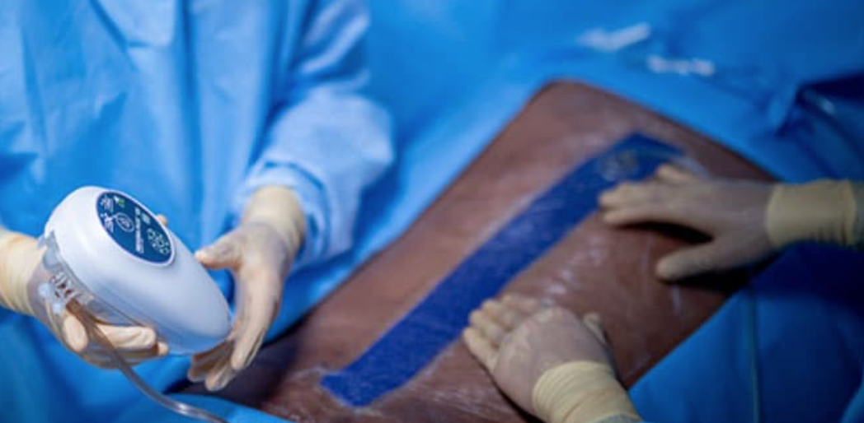
PREVENA
Negative pressure of 125 mmHg for up to seven days.
https://www.acelity.com/healthcare-professionals/global-product-catalog/catalog/prevena-incision-management-system
Notes:
continuous pressure on the surface of a closed surgical incision
Each dressing has 4 layers: a silicone adhesive wound contact layer, which is designed to minimise pain and damage during peel-back and to reduce lateral tension; an airlock layer for even distribution of pressure; an absorbent layer to remove exudate and bacteria from the wound; and a top film layer, which acts as a physical barrier and allows moisture to evaporate.
Speak> Single-patient use, lightweight and portable, replaceable canister, audible and visual alarms
Multiple dressing options for linear, non-linear, and multiple incisions

Slide 10
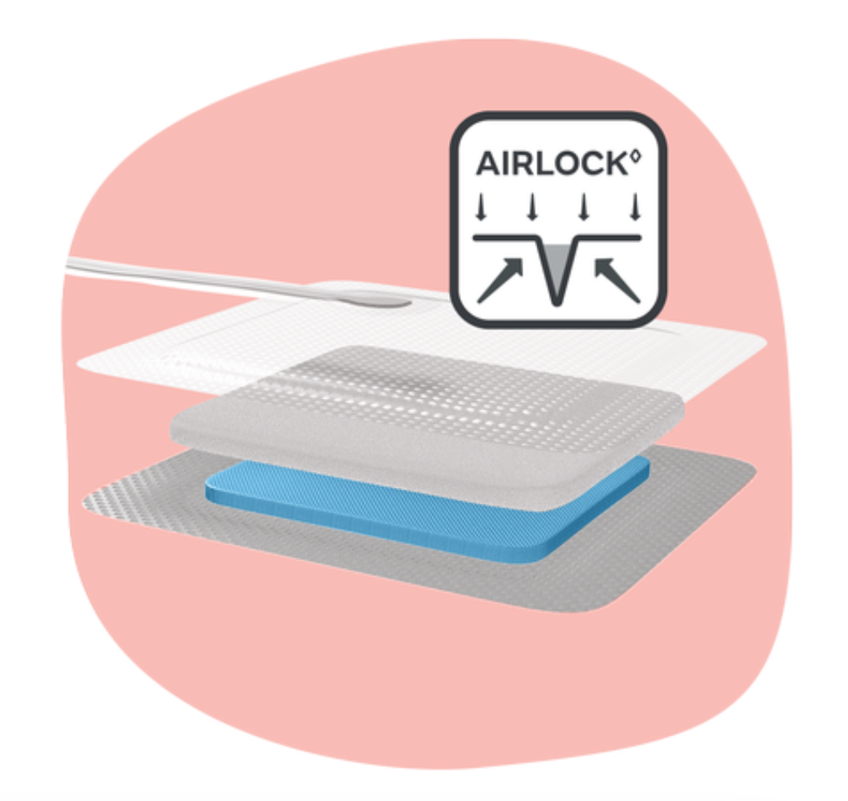
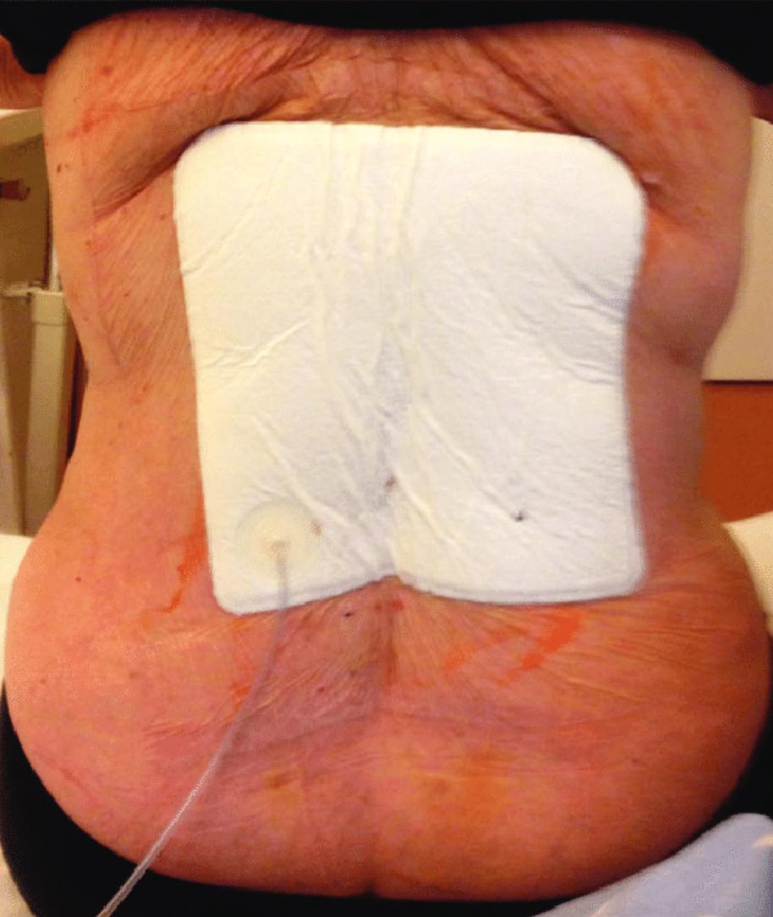
PICO
Continuous, even distribution of negative pressure of 80 mmhg
Portable, canister-free, single-use (4)
NICE guidelines https://www.nice.org.uk/guidance/MTG43
Notes:
Sterile pump and multi-layered adhesive dressings.
Each dressing has 4 layers: a silicone / airlock / absorbent / top film.
Difference:
Continuous, even distribution of negative pressure of 80 mmhg.
Portable, canister-free, single-use

Slide 11
Types of surgery
Bariatric patient
Total of 13*
Notes:
C3- T3 posterior stabilisation (Globus) and laminectomy from C3-7
T2-T6 and fusion
T10/11 and stabilization
Lumbar fracture fixation
Primary excision of lumbar intervertebral disc
Revisional posterior interbody fusion of joint of lumbar spine
Left L5S1 discectomy, L4L5 discectomy
Decompression
L2-L3
L2-5 and fusion
L1-L5 and L4-5 posterior instrumented stabilisation
L3-5 and fusion
L3/4 and posterior instrumented fusion
L1-S1 fusion and scoliosis correction, L2/3 XLIF
Non fusion
2 discectomies lumbar level
Fusion – 12
1 Cervical-thoracic level
2 thoracic level
8 fusions Lumbar level
1 lumbo thoracic

Slide 12
Demographics / comorbidities
Age
F
M
33
29
65
55
86
77
Notes:
What we are trying to say is tat no clear indication of use except large wound and some risk of wound healing
6 females, 33-85yo, 7 males, 29-77yo
GBS, autoimmune hepatitis
Breast cancer, mobility decreased, arthritis, cholecystitis
HTN, prostate cancer
Smoker
Ex smoker, punctured lung RTA 1997, CKD (ureteric stent), liver cyst, psoriasis, bilat oophorectomy
OA spine, depression
Obese
Smoker, ankylosing spondilytis, prostatectomy
Cauda equina, fibroadenoma, migraine
Functional neurological disease, GAD
Cervical spondylosis, CKD3, HTN, TIA 2019
DMt2. PE. HTN
Smoker, fibromialgia, ashtma, rectal cancer

Slide 13
Demographically-matched outcomes
Age
F
M
40
25
67
56
81
78
Notes:
stephen>:
2 weeks post decompression
-Ongoing dressings in community, every second day
-Small 0.5cm area distal aspect wound serosanginous dishcarge. No pus, no dischence, rest of wound looks helathy. No cellulitis.
-Patient feeling well, no worsening neurology
-Dressing with kerramax/tegaderm, managing with every second day change
-Had one course abx from GP for ?wound issues (clarithromycin), now completed.
-Advised if issue is simply of small slow healing area this can be managed with further dressings. If any pus discharge/cellulitis/pt
unwell/change in back pain or neurology to urgently rediscuss with ortho and we would see same day.
-Has appt next week SBAL
graham,:
During inpatient stay Mr Strachan developed a fluid collection around wound. MRI whole spine showed minimal fluid collection in the
epidural space at T8/T9 level.
Collection was aspirated and drain inserted to assist with drainage of fluid collection.
Size of collection has now improved and drain was removed on 29/5/23. District nurses have been contacted to assist with wound
care in the community.

Slide 14
Outcomes
None of 13 patients using iNPWT had Surgical Site Infection and the wound healed properly
2 of the 13 patients not using iNPWT had Surgical Site Infection
Notes:
7 patients healed well – discharge letter + follow up appointments
Reviewed post op notes, discharge letters, follow up letters, trak care notes while inpatient:

Slide 15
Conclusions
Ambiguous evidence regarding the use of iNPWT in spinal fusion procedures
Need for further use of iNPWT and audit of outcomes / do prospective study with patients using iNPWT in spinal fusion procedures
No clear guidance / indication of use in spine surgery except large wound and some risk of wound healing (comorbidities)

Slide 16
Limitations
Not looked at all patients who did not have iNPWT
Surgeon and patient specific - more evidence needed
Low number of identified patients with iNPWT
?incorrect coding in OPERA
Demographically-matched patients: unlikely to represent the true outcomes
Recommendations
Prospective study
Advocated use of iNPWT
Revisit and audit
Notes:
Audit / prospective study /
– larger number not us einpwt
Negative pressure wound therapy reduces incidence of postoperative wound infection and dehiscence after long-segment thoracolumbar spinal fusion: a single institutional https://pubmed.ncbi.nlm.nih.gov/24769401/
Negative pressure wound therapy for skin grafts and surgical wounds healing by primary intention https://pubmed.ncbi.nlm.nih.gov/25287701/
Negative Pressure Wound Therapy https://www.ncbi.nlm.nih.gov/books/NBK576388/
NICE guidelines https://www.nice.org.uk/guidance/MTG43
The lancet https://www.thelancet.com/journals/eclinm/article/PIIS2589-5370(23)00282-1/fulltext
imágenes https://www.semanticscholar.org/paper/Negative-pressure-wound-therapy-and-the-emerging-of-Kubek-Ba/1f494de78c390bd9f9a3668d113dcfcf5fbb2f7d/figure/3
https://www.3m.com/3M/en_US/medical-us/healthcare-professionals/surgical-solutions/spine/
https://www.researchgate.net/figure/Application-of-a-PICO-system-to-the-wound_fig5_275663306
Negative Pressure Wound Therapy https://www.ncbi.nlm.nih.gov/books/NBK576388/

